Slide 1
Diff eq pt 2 ch 11

Slide 2
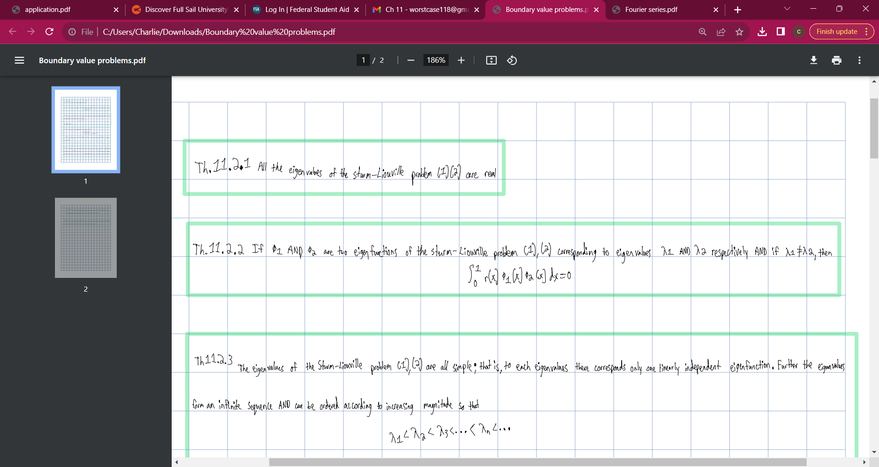

Slide 3
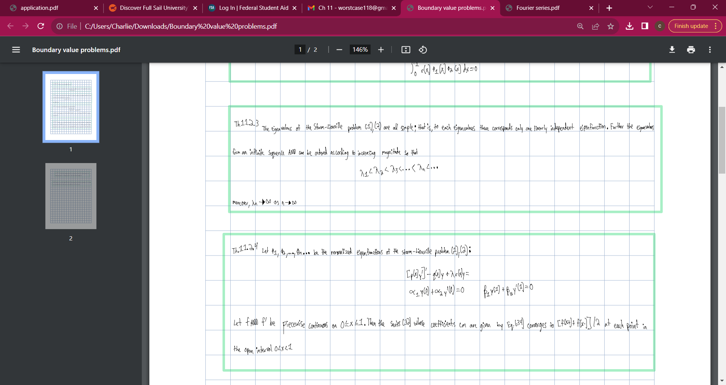

Slide 4
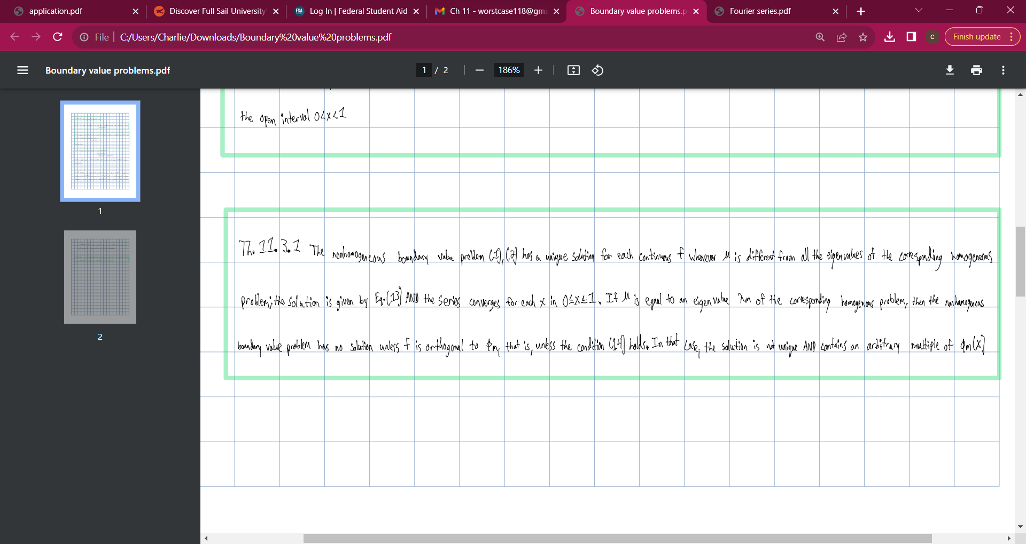

Slide 5
